Slide 1

3D CAD

Slide 2
For this module you are to CREO CAD for your 3D models.
If you are rusty in this department, one very good resource is
Youtube – CREO tutorial videos
The next few slides shows you how to log into the site.

Slide 3
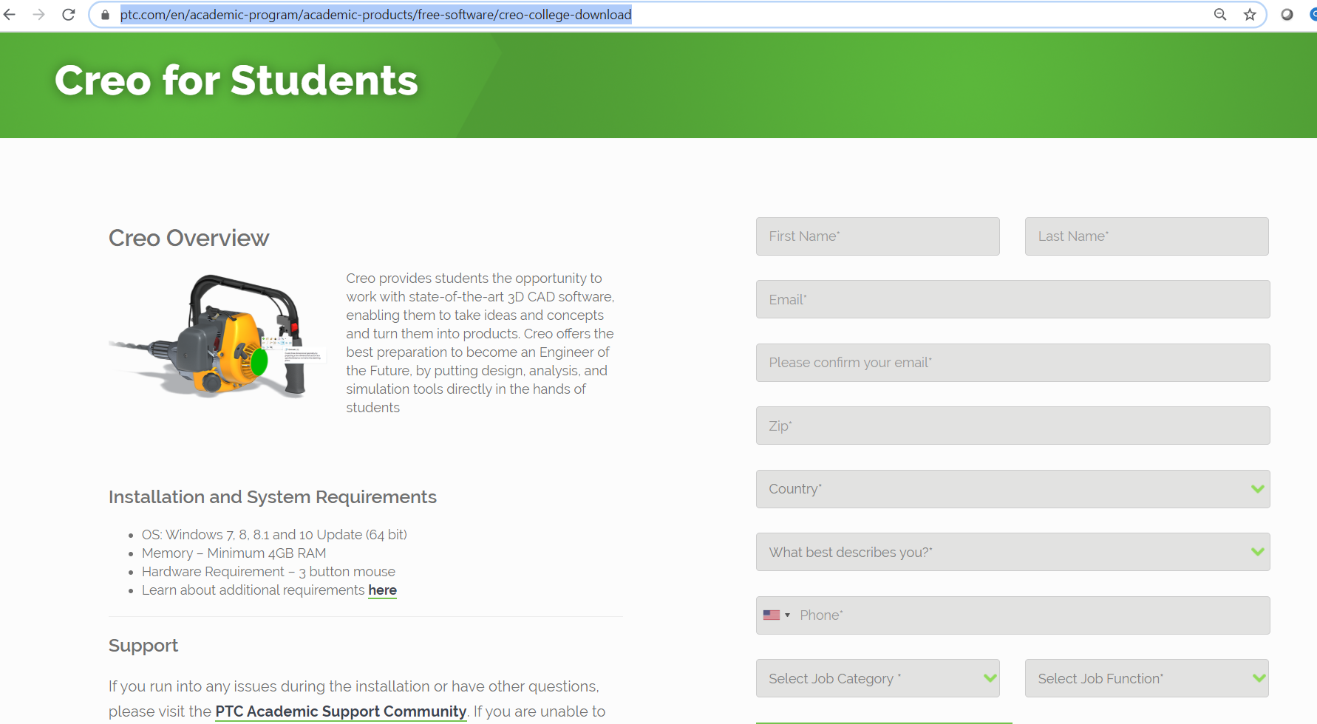
here are the link for students to download.
https://www.ptc.com/en/academic-program/academic-products/free-software/creo-college-download
After the registration, they will get a license starting with BE.text file.
This is how it looks like in the email they recevied.

Slide 4
